Slide 1
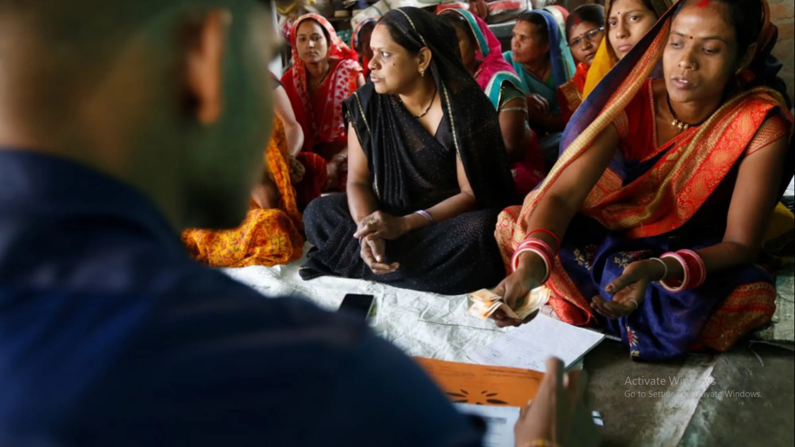

EMPOWERING
THE U N DE R PR IVIL EGE D

Slide 2






Executive Summary
Products – Loans under Joint Liability Group Model
Income generation loans
Water & Sanitation Loan
Yes Bank & CSB Bank Portfolio under BC Model
01
02
Company
Delhi based NBFC-MFI aiming to empower women
Qualified & Professional Management
Customer Focus
Under privileged customers
1st time loan takers mainly women who are
economically active
03
Company Snapshot
Portfolio – INR 204+ Crores
Number of active borrowers.—
64,000+
As on 31st March 2024
CARR at 29% on 31st Mar 2024
Operating in three States namely Rajasthan, Uttar Pradesh and Haryana August 2017
Exclusively for Women
04
05
Targeting an untapped market
Offering holistic loan & training solution
Using Cutting edge technology
Creating a wide Social impact

Slide 3


Problem - MFI loans are only extended to 5%
of the country’s population
Lack of access to services
Only 37% of women in India have a bank account
Limited awareness
Only 37% of women borrowers were aware of the concept of microfinance
No credit history
Women, particularly those engaged in informal sectors, lack a formal credit history, making it harder to get loans
01
05
02
Collateral and documentation
85% of women micro- entrepreneurs faced challenges in meeting collateral requirements
for loan
04
03
NO Business training opportunity
Training and learning opportunities for Women in Rural / Semi-Urban Areas are non-existent

Slide 4
MFI Is A Huge Market Opportunity Growing
At Fast Pace
MFI portfolio increased by 23.5%
Loan providers | Loan portfolio | % of overall portfolio
Banks* | ₹1.12 lakh crore | 38.4%
Microfinance NBFCs | ₹1.02 lakh crore | 35%
Small finance banks | ₹49,646 crore | 16.9%
2.93 lakh crore
2.37 lakh crore
Region | Share of portfolio
East | 23%
South | 27%
West | 16%
North | 15%
Central | 10%
Share
2021
2022
10%
23%
15%
6 crore unique borrowers
11.8 crore loan accounts
16%
27%
Tamil Nadu, Bihar and West Bengal have the largest loan portfolios
INR 400 Crore sanitation loans
with MFI’s
East
South
West
North
Central

Slide 5
Mission
01
To provide access to affordable financial services to 5 lakh economically under-served households for social and economic development by 2030
Humana Financial Services
Is a Growing NBFC-MFI Helping Create A Self- sufficient India
Vision
To secure life of dignity to poor, especially women and under privilege section of the society by providing financial services in the most efficient manner
02
Objectives
To empower poor especially women in skills to handle the credit funds in a judicious manner and contribute to employment and income generation
03

Slide 6



Humana Currently Offers
2 Types Of Loan Products
90% of Portfolio
Income Generation Loans
Amount – Rs. 20-80K Tenure – 12, 18, 24 Months Interest – 26% Loan Purpose - For income generating purposes like Agriculture, Transportation, Trading, and Production.
10% of Portfolio
Two types of Lending
Models
Own Books – 46%
Business Correspondence (BC) Model in partnership with Yes Bank and CSB – 54%
Water & Sanitation Loans
Eligibility Criteria
Annual household Income up
to 3 lakhs.
Maximum monthly loan repayment obligation (incl. applied loan) <= Rs.12500
Focus on Women
Amount - Rs. 20-80K
Tenure - 12, 18, 24 Months
Interest – 26%
Purpose - Enhance quality of life of members with loans for safe water & sanitation facilities

Slide 7

Enhanced Joint
Liability Group Model
Formation of Groups
01
Cutting Edge
Technology
Training of Groups
01
03
02
Documentation and paperwork
04
Loan sanction
02
Matured Process
Centre meeting and collection process
05
JOINT LIABILITY
GROUP MODEL
06
03
In-Depth Training-Financial literacy, entrepreneurship, skill building, market linkage
Follow Up on Loans

Slide 8














1. Cutting-edge Digital
Structure For Scaling And Diversifying
KYC using QR code
Offline operability for sourcing
Real time, on-line / off-line CB report, Geo-tags, Bio-metric enabled transactions, scoring linked assessment
Geotagging of centre meeting place
Real time credit bureau check
Digitized client life-cycle management including post disbursement checks with Geo- tags, photos etc
100% Cashless disbursement
Loan utilization check with geotagging
Digitized Internal Audit, Centre Quality Check and Compliance
Cashless repayment
collection
IVRS calls at
various stages
Client concern redressals
Digitized audit and access to partners

Slide 9
2. Matured Process –
Pre-Sanction
I -KYC Sourcing
II-Tele-calling
III- Group Formation
I -KYC Sourcing
Aadhar QR Reader, Auto Population, auto de-dupe, File Tracking is triggered
Auto check
a. Last time CB check?
b. In case of renewal clients, checks eligibility
c. The client has been rejected/pending in other groups
All clients are called, verified through cross questioning
Tele-calling decides independently to accept/reject, MIS is blocked for rejected followed by auto mailers
Additional responsibilities:
Calls for any OD case, same day directly to the client
Staff motivational calls
Target Achievement calls
Group Formation of Eligible clients
Pre-Populated LAF printing in branch, which minimise discrepancies
Pre-Populated means all the entries are checked before printing and it saves time

Slide 10
2. Matured Process –
Sanction, Disbursement & Collection
IV- Sanction &
Disbursement
V- Collecting & posting
VI- Monitoring
Sanctioning process/SND Upload
Disbursement Date, First EMI date update by branch, Veri Pay Solution
Disbursement in MIS, Repayment Schedule is generated along with demand sheet
Group Formation of Eligible clients
Pre-Populated LAF printing in branch, which minimise discrepancies
Pre-Populated means all the entries are checked before printing and it saves time
Audit Module, Internal Audit has information of every Centre, Group and Client
Centre Visit update in MIS
LUC update in MIS, HR module for Incentive, Automatic Data submission to credit bureau, Insurance Data

Slide 11
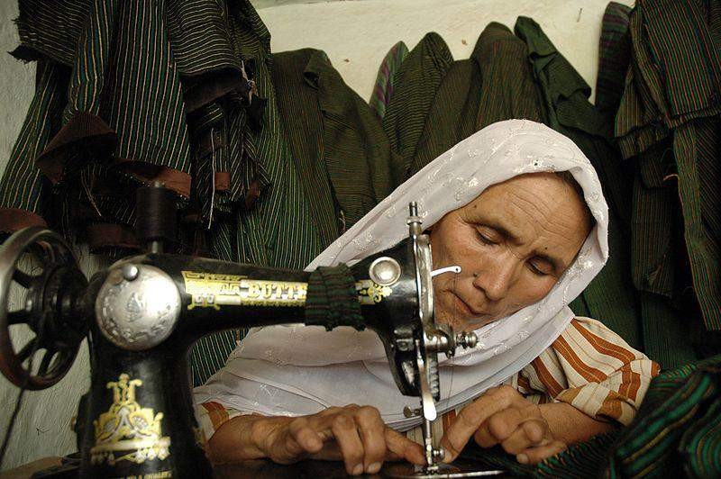



3. In-Depth Training Program –
Project “DISHA”
MULTIFOLD BENEFITS
01 | 02 | 03
Low chances of | Maximizes the | Helps in Lead
fund diversion by | chances of Business | Generation
borrower | Success hence loan
 | quality
1
2
3
Operational in 10 districts of 3 states, namely, Haryana, Rajasthan and Uttar Pradesh
01
02
Project ‘Disha’, an initiative of Humana People to People India (A Section 8 NGO- associate company of HFSPL) which provides entrepreneurship development programs for poor women

Slide 12


3. Program Details
& Impact of “DISHA”
Bridging Information Gap {BIG) Training for 36,000 women
Impact
01
Entrepreneurship information
Livelihood opportunities
Setting up of new businesses
For
Reporting Quarter
Year
To Date
(YTD)
Activity 1st | January to March 2023 | 31st | 1st | June 2021 March 2023 | to 31st
Target | Result | % | Target | Result | %
36,000 women will enhance their understanding on entrepreneurship ₃₅₀₀ | 3460 | 99% | 27500 | 25382 | 92%
02
EDP training to 7,200 women
Entrepreneurship development training (EDT)
Business development support through market linkages and skill building
Program
Details
Create and expand 4,800 new Nano Enterprises
By providing advanced financial literacy and
Digital literacy trainings
03
information, livelihood opportunities and setting up of new business and their growth
Rural Self Employment Training RSETI)
All women undergoing BIG will be motivated to be linked to vocational skill development trainings through RSETI/ DDU GKY/NGOs etc. for increased livelihood opportunities
7,200 women will receive intensive entrepreneurship development training and 700 business development
support
04
644
92%
4033
4530
112%
05
Special Events
Events such as Skill Melas , Business Information Fairs , introduction to various Skill Development programs , linkages to Government Social security schemes, banking and institutional support for entrepreneurship etc. will be conducted.
Creation and Expansion of 4,800 new Nano Enterprises
500
331
66%
2475
2191
89%

Slide 13




Our Journey so far
Since then
35
Branches
204+ Cr
Portfolio
64000+
Clients
21
Districts
May 1998
HPPI incorporated for the holistic development in the field of Education, Health and sanitation, Livelihood and environment
2007
Microfinance operations started, established branches and
2013
Started BC loan portfolio with YES bank
2016
HFSPL
incorporated, received Rs 5.1 Cr from HPPI as grant through a Trust- Humana Trust for Financial Inclusion and Development- (HTFID)
Aug 2017-2018
RBI license received. Soon after on fin Feb 2018 first loan disbursement was made
Feb 2019
The entity raised equity of Rs3.47 Cr and Rs3.92 Cr from Humana Planetaid and Finance (HPAF) and (HTFID)
Feb 2024
We obtained equity worth 1 Crore rupees in the form of a CCD from M-Swasth.
May 1998
2007
2013
2016
Aug 2017-2018
Feb 2019
Feb 2024

Slide 14
Current Microfinance Operations
As on 31st March 2024
Fund contribution (Rs.in crs.)
0%
Share Holding Pattern
1,593,384 16%
53%
47%
8,479,230 84%
Fund Contribution
Humana Trust for Financial Inclusion and Development Humana and Planetaid Finance SA
AUM and Collection efficiency
Return Ratios and Capital Adequacy (in %)
37.1%
37.8%
204.23220 99%
₂₀₀ 98%
₁₈₀ 98%
97%
160 _{97%}
140 96%
₁₂₀ 96%
95%
100 _{95%}
⁸⁰ 94%
60 94%
30.2%
24.1%
29.2%
29.0%
177.41
27.4%
149.04 148.54
151.08
159.96
Axis Title
129.34
137.3
19.8%
13.4%
15.8%
14.8%
6.0%
6.1%
4.8%
3.5%
1.6%
3.8%
4.3%
Jun/2022
Sep/2022
Dec/2022
Mar/2023 Jun/2023
quarter ended
Sep/2023
Dec/2023
Mar/2024
Mar/2021
Dec/2021
Sep/2022
Period ended
Jun/2023
Mar/2024
POS
Collection efficiency
Linear (POS )
ROA
ROE Capital Adequecy ratio

Slide 15












Operations
and NPA Analysis
Case load of clients per Field Executive
PAR analysis on Total AUM
PAR 90+
524
6.4%
475
430
456
366
375
2.1%
0.8%
1.4%
1.6%
Mar/2021 Mar/2022 Mar/2023 Sep/2023 Dec/2023 Mar/2024 PERIOD ENDING
0.7%
Mar/2021
Mar/2022
Mar/2023
Jun/2023
Dec/2023
Mar/2024
PAR 30+
PAR 60+
9.1%
7.8%
2.7%
2.2%
2.6%
1.3%
1.2%
2.4%
2.0%
1.8%
0.8%
1.0%
Mar/2021
Mar/2022
Mar/2023
Jun/2023
Dec/2023
Mar/2024
Mar/2021
Mar/2022
Mar/2023
Jun/2023
Dec/2023
Mar/2024

Slide 16

































Powered By Solid Industry
Partnerships
Institutional investors
BC partners
Domestic & International lending partners including Banks, DFIs, Funds and NBFCs

Slide 17
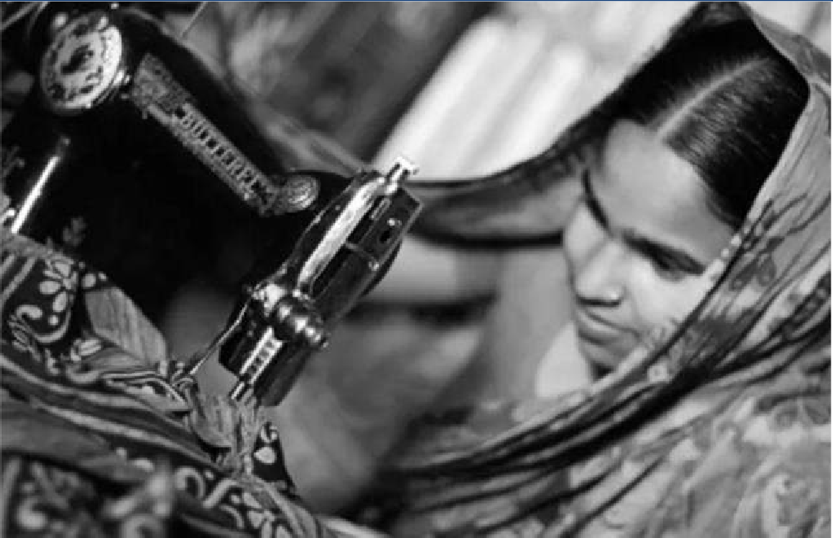

Unprecedented Value
Proposition & Impact to Borrowers
Impact
Created
50% Lesser Interest-Rate than Money Lenders
Super-Fast turnaround time for disbursement
Minimum documentation requirement, no credit history needed
Brings them into mainstream credit system
Driving entrepreneurship
Creates new job opportunities
People to People Approach
Clients improved since
2018 69,188 out of 1.2 Lakhs
Impact
Created
70.0%
45.1%
132223
Loans Sanctioned
116703
Unique Women Borrowers
4000+
New Businesses
Created
Sep 2022
June 2023

Slide 18



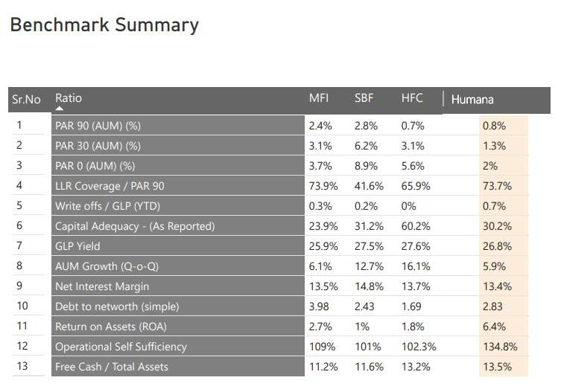
Competitive Advantage
01
25 years of experience
in promoting social development in financial inclusion and livelihood fields
High quality loans with a very low
GNPA of 1.4%
02
BENCHMARK SUMMARY
03
High profitability with 40% repeat customers
Advanced Entrepreneurship Training
Programs for Clients
04

Slide 19
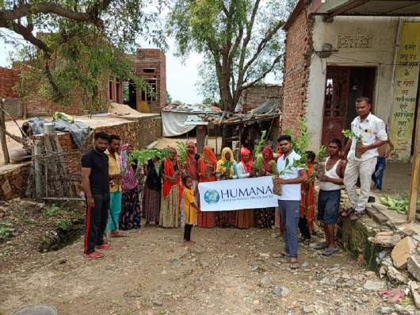
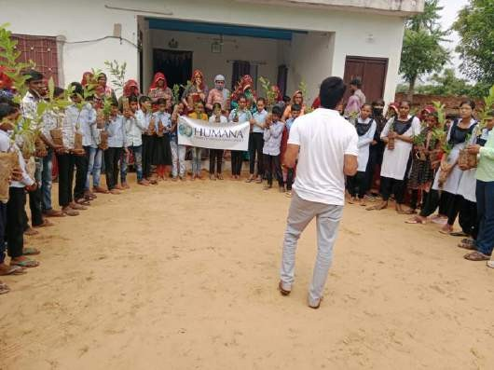
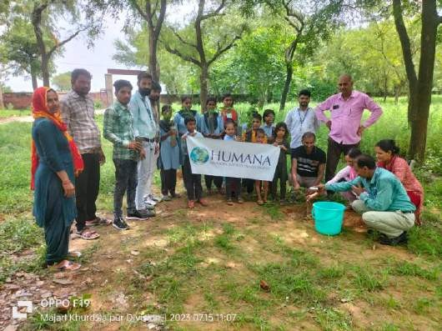


Plantation Activities Organized
By HFSPL Every Year
01
We have planted Rs.1.5 lakhs plants in last 5 years and this year we have invested 30 k in plantation activity to our mother earth and we’ll do more in future
Let's keep planting, nurturing, and growing. Together, we can build a greener, healthier, and more sustainable world
02

Slide 20
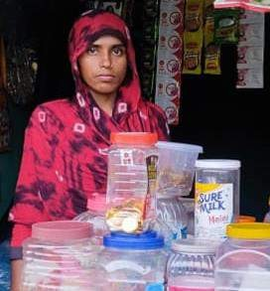
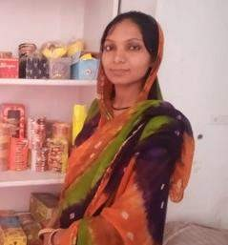
Testimonial/Case Study
Sitara Bano is a resident of Shivnagar village in Moradabad district of Uttar Pradesh .His husband used to work as a daily wager
In order to meet the daily needs of her family, Sitara wanted to start a small business of her own During community interactions she came to know of Humana Financial services Pvt Ltd.
Humana team along with members of Disha Project facilitated her in preparing a business plan, provided entrepreneurship training and market linkages for the same. Upon review of the business plan, she was provided a loan of Rs. 40000, which was invested in starting the shop.
From daily wager to empowered entrepreneur – Meet Sitara Bano! With Humana Financial Services' support, she's now a proud shop owner, doubling her family's income. Let's celebrate her journey from strength to strength! 💪🛍️ #EmpoweredWomen #Entrepreneurship #HumanaFinancial #ChangingLives
Meet Mona Petal, a determined 24-year-old mother of three girls from a poor family. With just a 10th class education, she was struggling to make ends meet while her husband worked as a laborer.
Enter HFSPL - a game-changer! They introduced Mona to a world of possibilities with their loan and support. Now, she runs a successful business from home, earning 6000 to 8000 rupees a month. Thanks, HFSPL! Empowering women, transforming lives. Join us! 🌟💪 #Grateful #Empowerment #HFSPL #ChangingLives

Slide 21
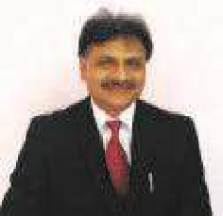
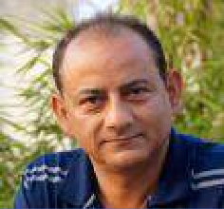
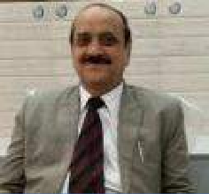
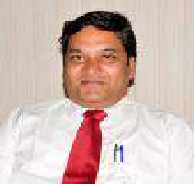
Board Of Directors
Kailash Khandelwal
Managing Director
59
A veteran in development sector with 21 years of experience. Kailash joined Humana People to People India in year 2000 as a Senior Program Officer in Community Development Project and joined the Board of Directors in 2012. One of the four board members of HPPI and a Vice Chairman for Humana People to People Microfinance, Kailash functions as a National Program Manager and working on complex projects in rural livelihood and community development with core focus on administration, economy overview, capacity building and partnership liaison with government
Sanjeev Bhatt
Director
56
Mr. Sanjeev Bhatt serves as a director on the board of Humana People to People India since 2001. He is heading the Grant Administration team. his association with HPPI started in 1998 as a program officer for the first Community Development project in Alwar District, Rajasthan. Sanjeev was part of initiating the microfinance program in HPPI and then HFSPL. He was commemorated with the Indian Achievers Award for Social Service for his outstanding voluntary contributions to social service at the 15th National Seminar on Emerging India.
Ashok Kumar Pahwa
Independent Director
72
More than 38 Years of distinguished service in Indian Overseas Bank with a business mix of more than Rs4,000 Crore. Business handled was large corporate, mid Corporate, SME & retail banking, Project Finance, Housing loans, Loans against property, Mortgages and business loans, Audit, Compliance, Operations and compliances
Ashish Kumar Gupta
Additional Independent Director
42
Mr. Ashish Kumar Gupta (39) has got a varied experience in the field of microfinance and livelihoods promotion while working in varying organizational set-ups Eviz NGO, Government Project, Development Company, Microfinance Institutions, Consultancy set-ups, Self-promoted Enterprise, etc. He is featured as one of the six Social Entrepreneurs in a book titled ‘Pursuit of Goodness and was also the winner of the first nationwide ‘Social Entrepreneurship Search Competition - SRIJAN’, organised by Aavishkaar India and others.

Slide 22
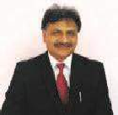


Governance
Board Functional Committees
Sr. No. Name of the Committee Members of the Committee | Frequency of Review
 | Items Reviewed Frequency
1 Audit Committee
Ashish Gupta (Chair), Ashok Pahwa & Sanjeev
Bhatt
Review and Action taken on
Internal Audit team's findings
Quarterly
2
Risk Management
Committee
Kailash Khandelwal, Ashok Pahwa (Chair) & Ashish Review of Operational, Liquidity
Quarterly
Gupta
and Political Risks
Policy related to remuneration
3
Nomination & Remuneration Committee
Kailash Khandelwal & Sanjeev Bhatt
policy and appointment of key personnel
Annually
4 Fund Approval Committee Kailash Khandelwal & Sanjeev Bhatt
Approval of Funder &
source of Fund
As on when
requires
Management Team
Mr. Kailash Khandelwal | (Managing Director)
A seasoned practitioner with over 2 decades of experience, he has extensive experience in the design and management of development interventions in large scale projects across different verticals. He has rich experience in Microfinance Operations, Strategy and Planning, Business Analysis and Development, Community development projects, Project implementation, Fundraising, establishing linkage of Bottom of Pyramid with market, Capacity building as a director of Humana People to People India and Humana People to People Microfinance
Sudhanshu Shekhar | CFO
Sudhanshu has Post Graduation Diploma in Rural management from XIM, Bhubaneswar and degree in Bachelor of Arts from JNU. He has over 18+ years managerial experience, including over twelve years of experience in microfinance sector. In the past he worked in entities such as M-CRIL, BASIX, Intellecap, Kas Foundation and GE Capital, USA & France
Raj Kumar Singh | CEO
Raj Kumar has over 15+ years of experience with Humana, he is a key Member of HPPI Head Quarters’ Senior Management, has extensive experience across various development areas and instrumental in project initiation and development. Mr. Rajkumar started Microfinance Project as pilot and later developed as full-fledged Microfinance operations from Rajasthan in 2007. As on date he is the CEO of HFSPL. He has 13 years of Micro finance in microfinance operation.

Slide 23




Expansion Plans
Post Fundraise
Opening newer branches &
01
Enter new Regions
Opening of ten new branches
Expansion in east UP, Bihar along with other states
Invest in
Technology
Tech initiative-1
Tech initiative-2
Tech initiative-3
Introduce new
product
MSME Loans
Targeting – Small Businesses
Loan Size – Rs1-5 Lakh
03
02

Slide 24


















Funding Base As On
31st March '2024
New Fund and Partnership status during the Current FY
IDFC First Bank
Eclear Leasing & Finance Pvt Ltd
Nabasamriddhi
Blacksoil Capital
Vivriti Capital
Total disbursement of 204 Cr+ till Mar 2024
In this FY, Humana also added CSB as its BC partner in addition to our existing relationship with Yes Bank Ltd. Disbursement to take place from Apr’23
Added Vivriti Capital, Blacksoil Capital, Ambit Finvest, Nabsamruddhi and Real Touch as new Lenders.
In February 2024, we obtained equity worth 1 Crore rupees in the form of a Compulsorily Convertible Debenture (CCD) from M S-wasth.
Grading of Alpha-
Expects to close Own Portfolio at Rs.100crs+ with total AUM would be 200crs+
Graded Top with C1 by M-CRIL in CoCA covering Transparency- Client Protection, Governance, Recruitment, Client Education, Data Sharing, Feedback and Grievance Redressal
Ambit Finvest Real touch
Maanaveeya
UC Inclusive
State Bank of India
Caspian Impact Investments
DCB Bank
InCred Financial Services Limited
Union Bank of India
FWWB
AU Small Finance
Bank
Usha Financial Services Pvt Ltd
Arohan Financial Services Ltd

Slide 25
Financial Projections
Return Ratios and Capital Adequacy (in
%)
29.6%
24.5%
26.9%
29.1%
27.0%
30.2%
28.2%
29.5%
19.9%
25.5%
Own and BC Portfolio (In Cr)
924.1
5.6%
5.6%
5.8%
5.8%
4.2%
Mar-2025 Mar-2026
Return on Assets
Mar-2027
Return on Equity
Mar-2028 Mar-2029
Capital Adequacy Ratio
692.1
422.7
528.3
473.4
450.7
Equity,D/E and OSS
299.8
350.7
140.0
4.00x
3.50x
3.00x
2.50x
2.00x
1.50x
1.00x
0.50x
0.00x
265.7
3.34x
3.48x
120.0
3.12x
3.15x
3.03x
D/E and OSS (in times)
210.8
341.4
100.0
80.0
60.0
148.5
262.7
Equity (in crs)
211.8
151.3
1.36x
1.35x
1.35x
1.36x
1.27x
40.0
20.0
Mar-2025
Mar-2026
Mar-2027
FY ending
Mar-2028
Mar-2029
-
49.6 71.7
Mar-2025 Mar-2026
88.3
114.9 114.2
Mar-2028 Mar-2029
Own Portfolio
BC Portfolio
AUM
Mar-2027
FY Ending
Equity
Debt Equity ratio
Operational Self Sufficiency

Slide 26


THANK YOU
+91- 93109 39791 | https://humanafinancial.com/Home/Index#top |sudhanshu@humanafinancial.com

